Slide 1

You Smoke,
You Choke!
By, Mark, Roop and Yasmin

Slide 2

WHAT ARE WE RESEARCHING?
We are creating a project about the sheer amount of impact smoking can cause on individuals. In this project, we will be looking at how much smoking has cost people over the years, looking at how prices have risen. We will also be looking if the number of smokers has risen or fallen over the years by using bar graphs. As well as, we want to focus our data on smoking habits.
We want to lay out this project as an anti social smoking campaign for young people. We are doing this project because we are all passionate about the effects that smoking has and we want to raise awareness.
We are going to create a dataset that analyses whether people have quit smoking.

Slide 3
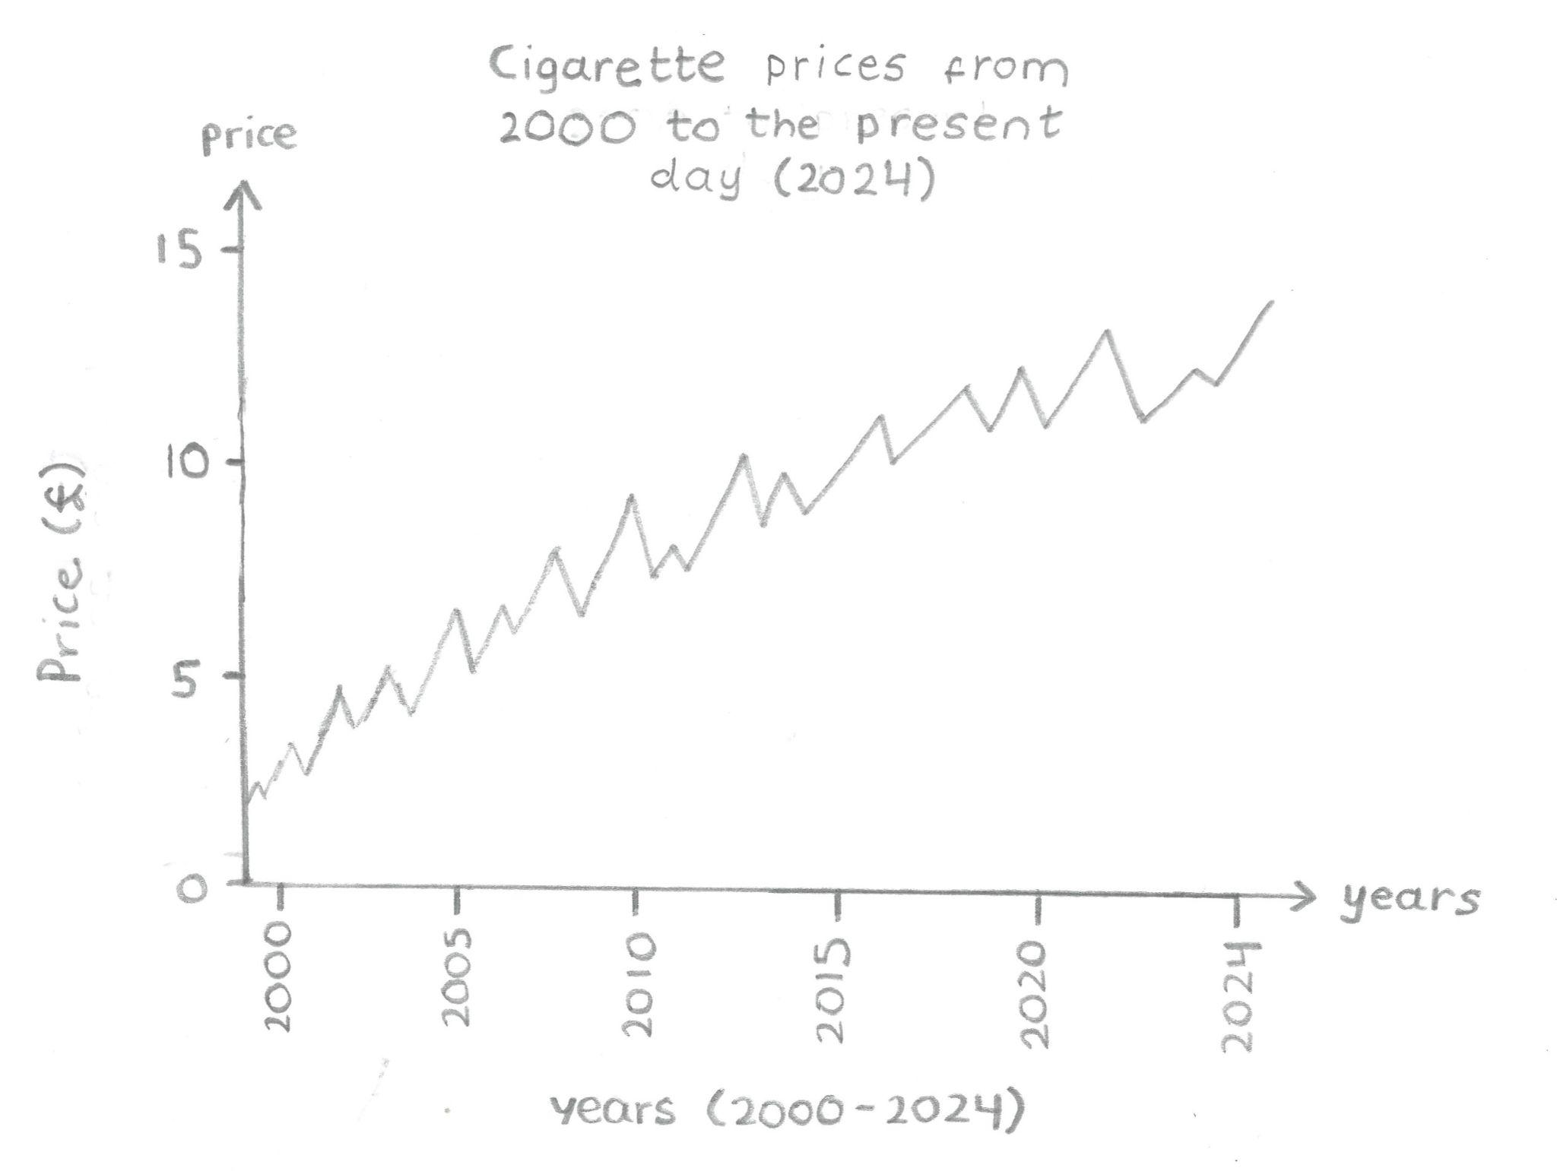
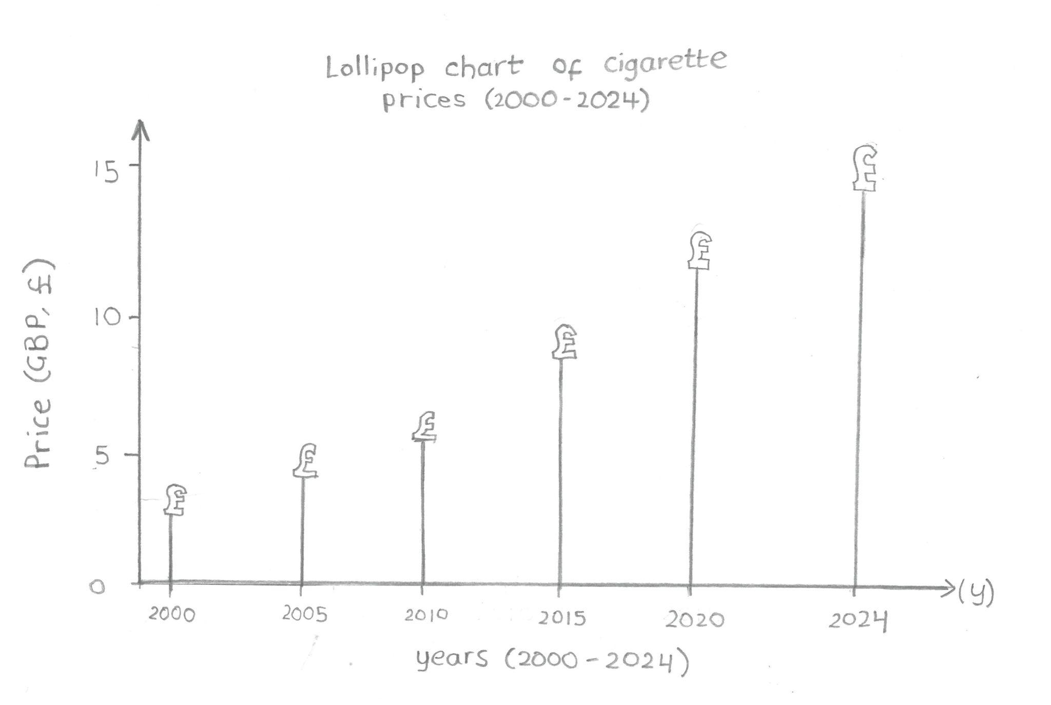
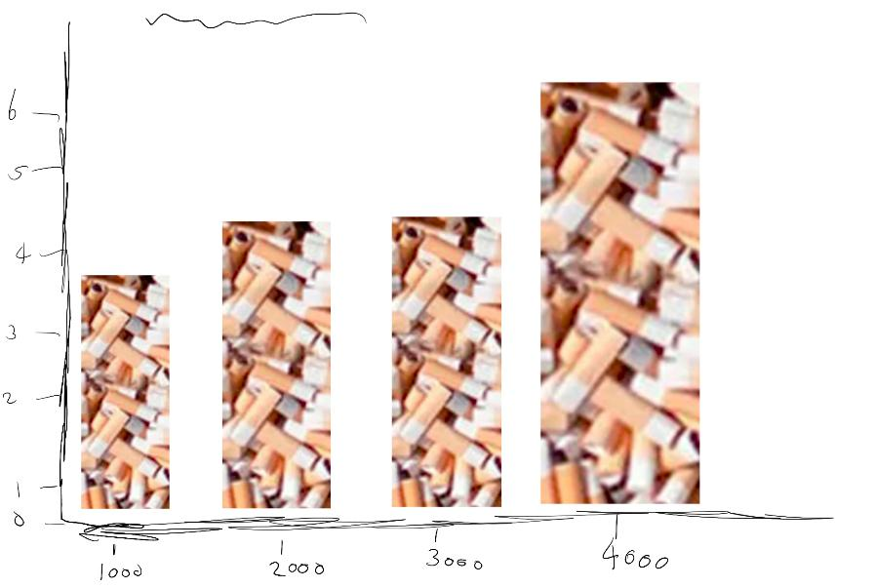
IDEAS OF GRAPH REPRESENTATION

Slide 4

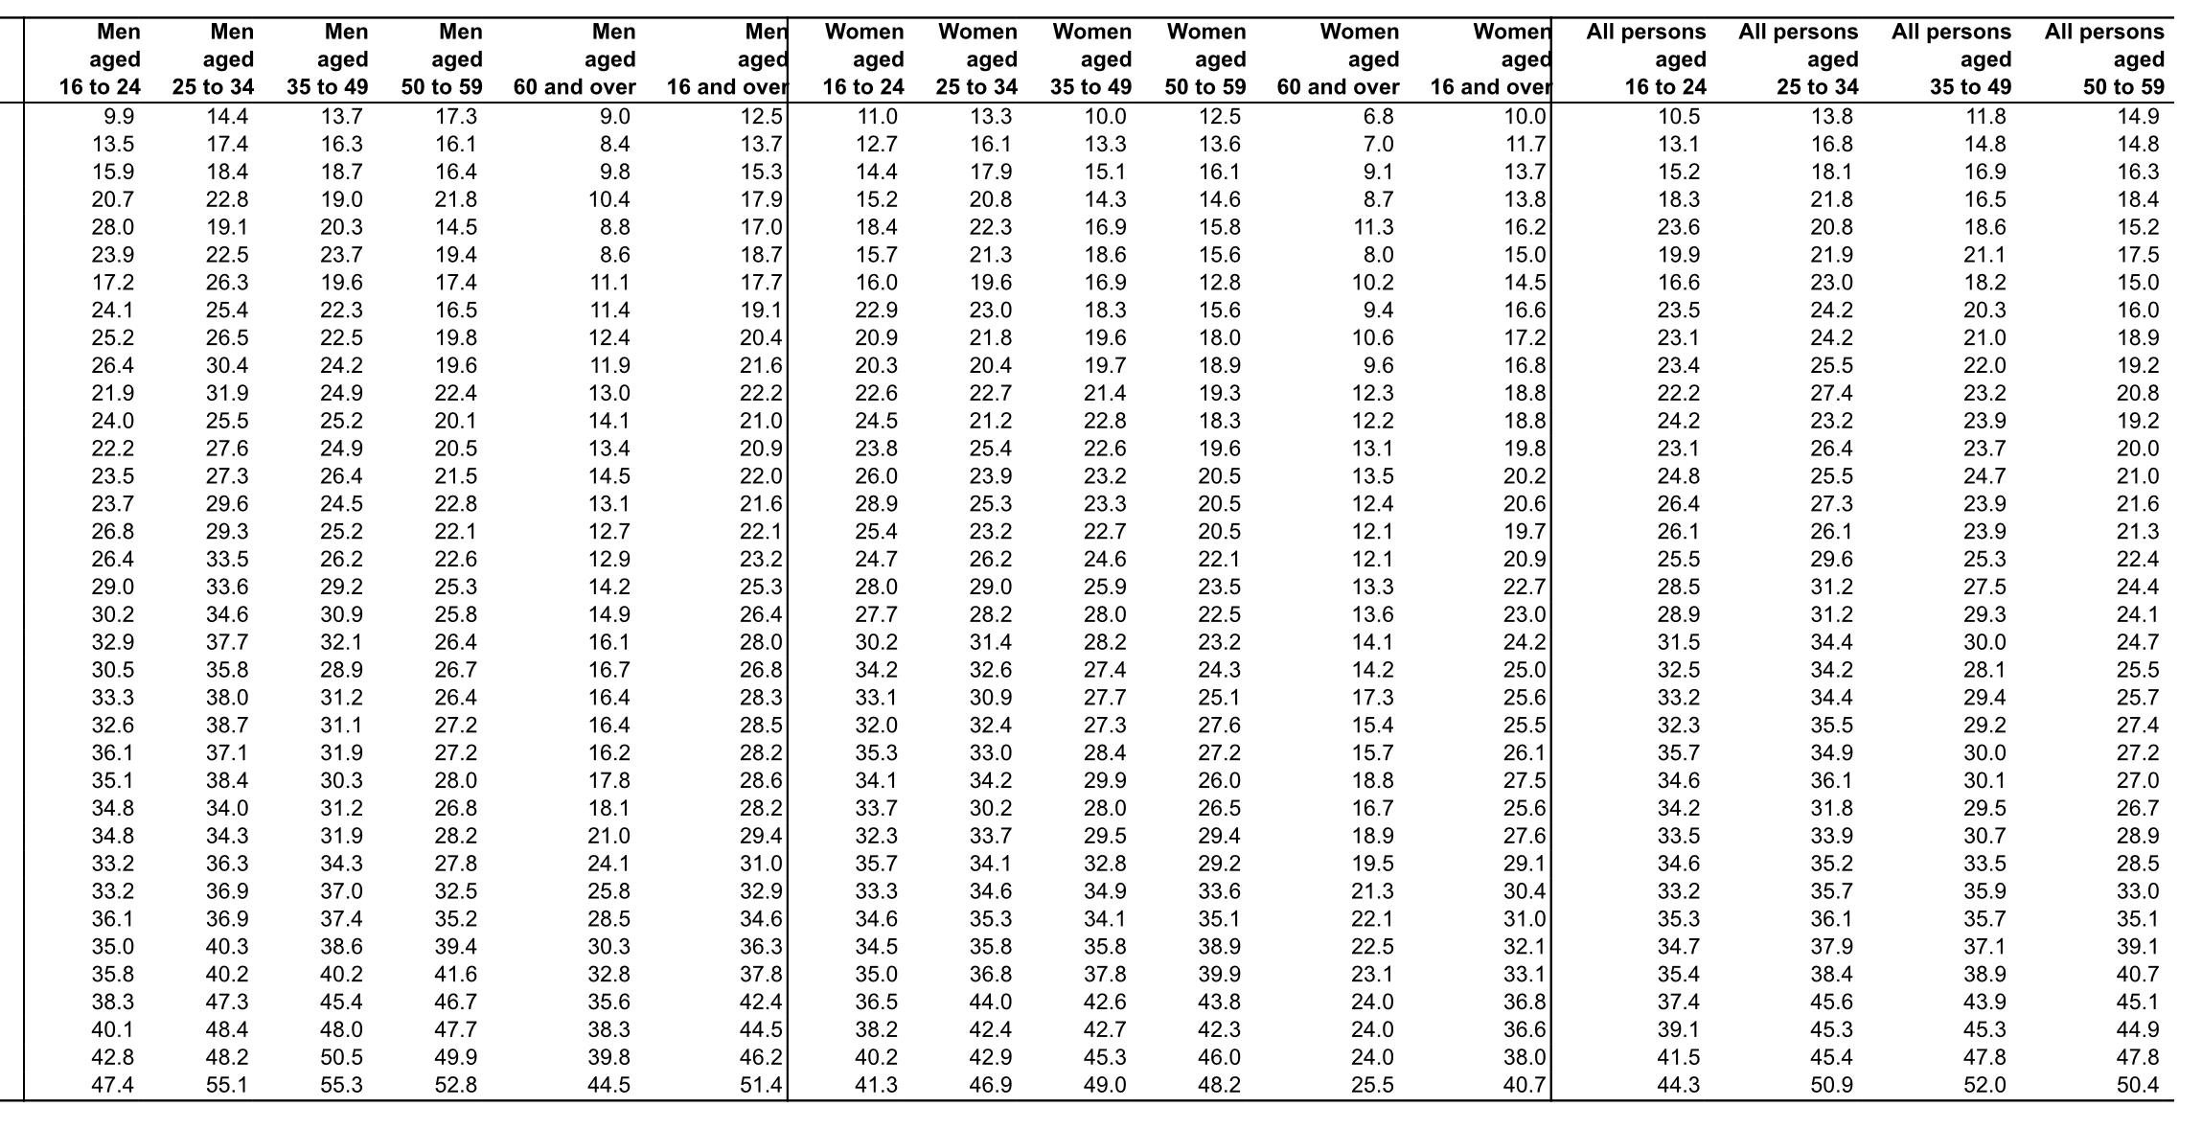
SOURCE 1
Smoking Habits in the UK 2022
By National Office for Statistics
We will be using a spreadsheet that contains datasets of adult smoking habits, published by the Office for National Statistics. The spreadsheet was published in 2023, making our dataset relevant. In the dataset, it represents data of cigarette smokers in the UK by looking at both men and women from 16 to 60 and over. Aesthetically it is boring and very complicated, so people wouldn’t pick it up immediately. Our aim is to present this database which is easily understandable for our target audience. From the dataset for people who are cigarette smokers, there is no indication for the men, women and all persons columns since they look the same aesthetically, which can get confusing. Furthermore, the ‘all persons’ column is not very specific as to what it actually means. We will also be utilising the data spreadsheet for people who have quit smoking.

Slide 5
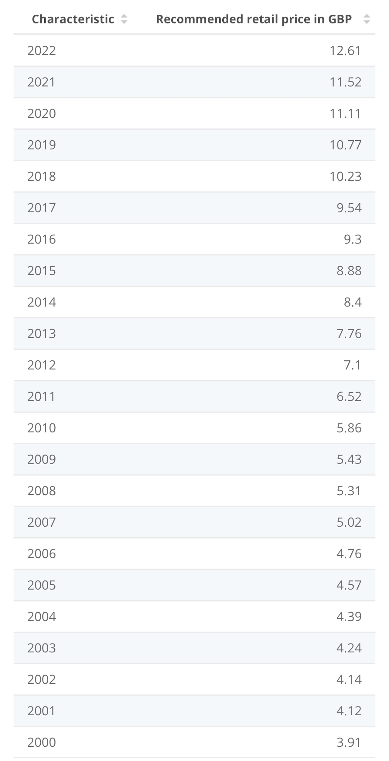
SOURCE 2
Average retail price of a typical pack of 20 cigarettes in the United Kingdom (UK) from 2000 to 2022 (in GBP)
On our website, we will feature a comprehensive data set from Statista detailing the rise in cigarette prices in the United Kingdom from 2002 to 2022. This information will be presented in a user-friendly format, allowing our viewers to observe and understand the long-term trend of increasing costs associated with smoking. By examining this data, viewers can gain insight into economic factors, such as inflation and taxation, which influence the retail prices of consumer goods.Viewers can benefit from this data by being better informed about the financial implications of smoking over time. It could also serve as a deterrent to potential smokers and as a motivator for current smokers considering quitting due to the rising costs and they will really be able to visualise and see the long term implications
Statista reliability stems from its 13 years of experience as a market leader in providing business data. Their commitment to delivering accurate insights and facts across a wide array of industries and countries has earned them a reputation for trustworthiness. This reliability is crucial for our website as it ensures that the information we present is credible and can be used for informed decision-making or academic research.

Slide 6
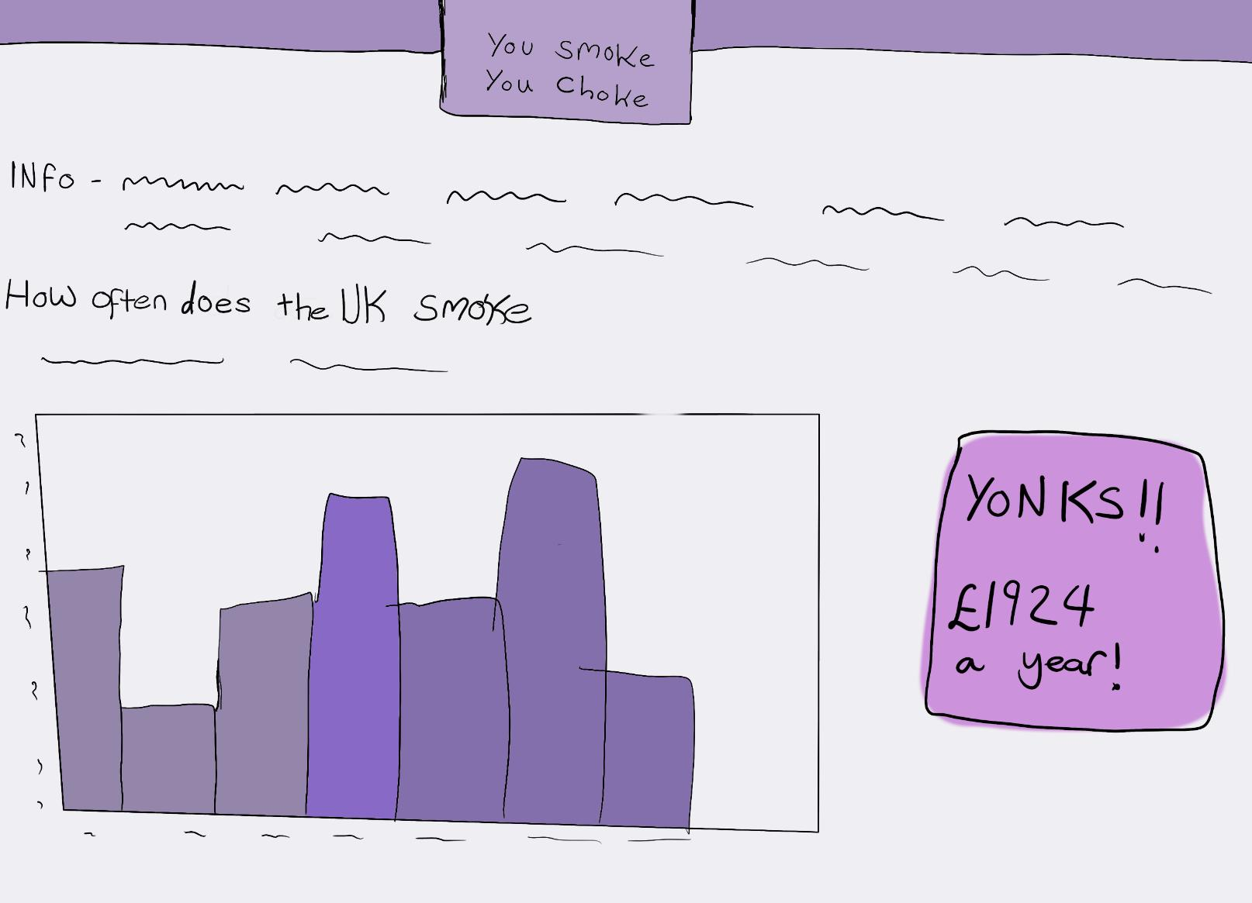
AESTHETIC CHOICES
We want a website that appeals to young people 18-25. We want a scroll-down website that’s all in one page since it is easier to navigate and so young people can have the attention span since they can scroll down and look at the different facts without missing anything. If there were too many links, not many young people would click on it. We also want it to be bold, bright and eye-catching that attracts the scroller’s attention. We were influenced by the Stop Smoking London webpage, since it has interactive features that allows people to engage with the sources. So, we want a pastel theme.

Slide 7

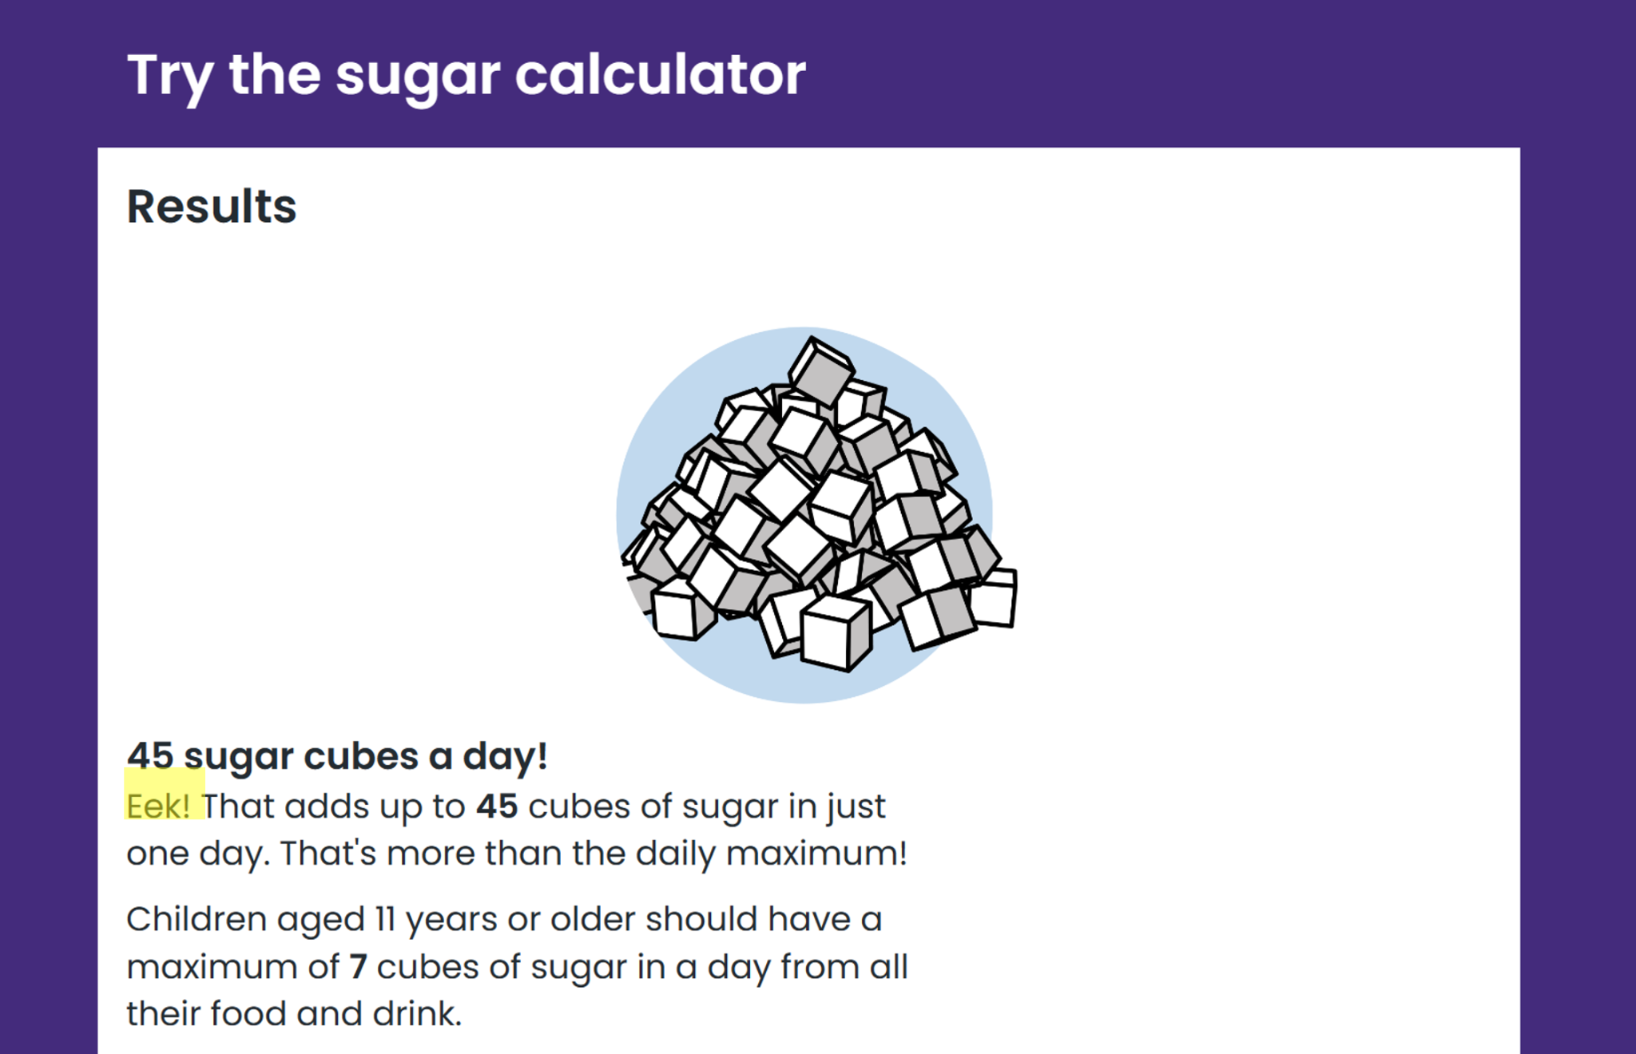
Tech Choices
One tech choice we chose was to create a website which will scroll down, there will be no other links. Inspired by Tik-Tok we found that it keeps users more engaged then, normal as they wont be clicking other links. Furthermore, in our findings only 48% of people click to the next tab meaning creating a website which revolves around scrolling is the best way to show our information.
The word ‘Eek!’ given on the sugar cube calculator on the NHS webpage inspired the word ‘Yoinks!’ we plan on putting on our flip cards. Yoinks proves to be a far better exclamation to make it more lively and to also tailor it towards the target audience.

Slide 8
Issues we may encounter
One problem we will face is coding the data base which will be shaped as a cigarette, we are not strong coders and will have to use W3 schools and other resources to help us, while we make this data set.
Another issue we will face is finding the small problems with the code and finding out how to fix it.
We will find it difficult to meet up after are scheduled lessons as we will be busy with work/uni work.

Slide 9
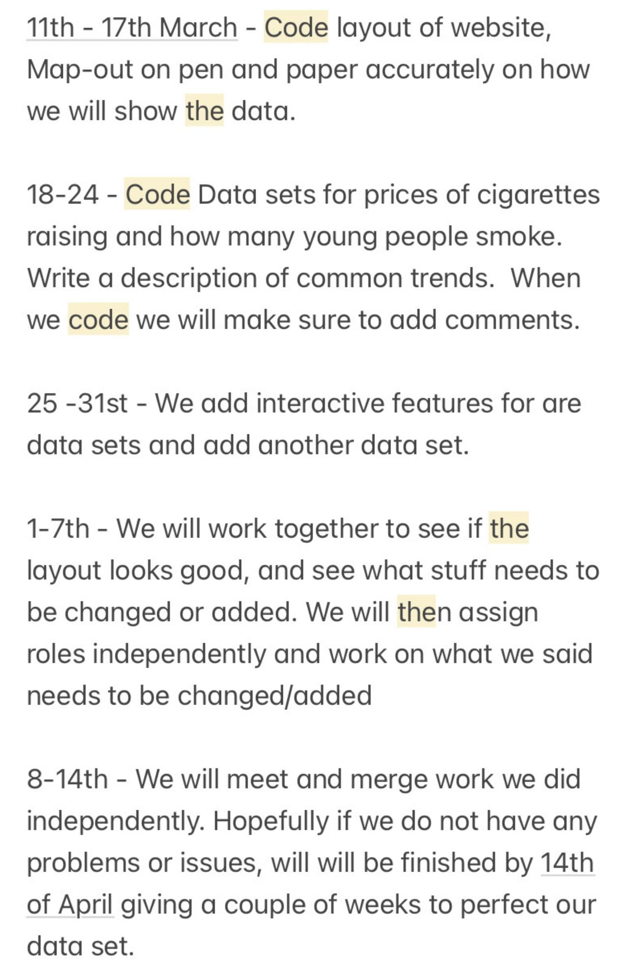
PRODUCTION TIMETABLE

Slide 10
Thank You!

Slide 11
References
https://www.ons.gov.uk/file?uri=/peoplepopulationandcommunity/healthandsocialcare/drugusealcoholandsmoking/datasets/adultsmokinghabitsingreatbritain/2022/adultsmokinghabitsingreatbritain.xlsx
https://www.ons.gov.uk/file?uri=/peoplepopulationandcommunity/healthandsocialcare/drugusealcoholandsmoking/datasets/adultsmokinghabitsingreatbritain/2022/adultsmokinghabitsingreatbritain.xlsx
https://researchbriefings.files.parliament.uk/documents/CBP-7648/
https://commonslibrary.parliament.uk/research-briefings/cbp-7648/
https://ash.org.uk/uploads/Facts-At-A-Glance-Fact-Sheet.pdf?v=1697723952
https://files.digital.nhs.uk/1E/3A7D18/stat-smok-eng-2020-tab.xlsx
https://webmasters.stackexchange.com/questions/102602/how-do-i-determine-how-many-users-click-next-given-next-exist
https://www.nhs.uk/healthier-families/food-facts/sugar-calculator/
https://www.statista.com/statistics/414973/cigarette-prices-in-the-united-kingdom/

